Slide 1
Team 5
Project :- AI Chess Engine
Project Contributors
BIKASH PRADHAN 13030523022
DEBAGNIK DEY 13030523024
SANDIP SEN 13030523048
TIRTHES SAMANTA 13030523059

Slide 2



Project Purpose and Chess Engine Challenge
Chess serves as a classic benchmark for artificial intelligence, requiring a perfect blend of rigid rule enforcement and heuristic-based decision making. This project aims to build a functional chess engine in Python that handles the complexities of the game while providing a competitive AI opponent.
The Problem Statement
1. State Management
2. Rule Complexity
3. Search Space
Accurately tracking 32 pieces across 64 squares through thousands of possible permutations.
Implementing non-linear rules such as castling, en passant, and pawn promotion.
Navigating the "combinatorial explosion" where the number of possible move sequences exceeds capacity.

Slide 3




System Architecture and Board Representation
The engine is built on a modular architecture that separates the game state from the decision-making logic.
Move Generator
AI (Minimax)
Data Structures
Board Representation
2D 8×8 list where each element stores a piece object or null.
GameState
(8x8 Array)
Piece Encoding
Strings (e.g., 'wP', 'bK') for rapid lookup and rendering.
Move Log
Python/Pygame UI
Stack-based history that enables undo functionality for AI search.
Rule Validator

Slide 4
Legal Move Generation and Piece Validation
Piece | Movement Logic | Special Constraints
Pawns | Forward 1 (or 2 on start), Diagonal capture | En Passant, Promotion
Knights | Fixed "L" shapes (2x1) | Can jump over other pieces
Sliding | Ray-casting (Rook, Bishop, Queen) | Blocked by friendly/enemy pieces
King | 1 square in any direction | Castling (requires safety check)
Validation Pipeline
01
02
03
Pseudo-Legal Generation
Safety Check
Final Filter
Calculate all squares a piece can physically reach.
Temporarily apply the move and check if the King is under attack.
If the move results in a self-check, it is discarded from the legal move list.

Slide 5
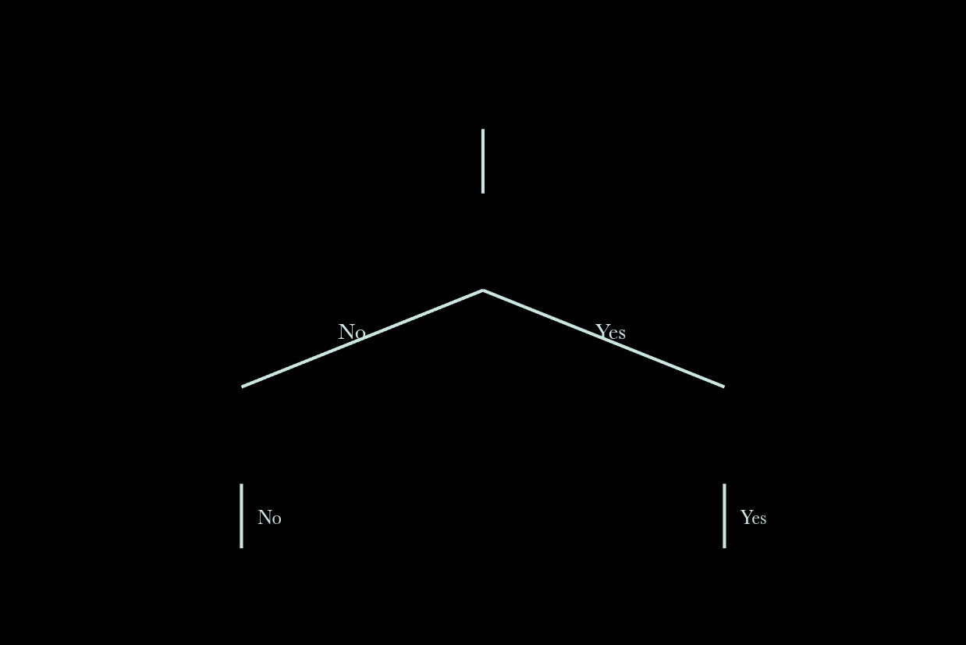
Check, Checkmate, and Stalemate Logic
TERMINAL STATE DECISION TREE
End-Game Detection Flow
Are there legal moves?
Check: Occurs when the King's current square is among the opponent's valid capture targets.
Is King in Check?
Checkmate: Triggered when the King is in check and the "Legal Move List" is empty.
End game
Stalemate
Checkmate
Stalemate: Triggered when the King is not in check, but the player has no legal moves.

Slide 6


AI Opponent with Minimax Search
Search Strategy
The Evaluation Function
1
Legal Moves
Found all the legal moves available.
2
Move Ordering
Sort the legal moves by priority order.
3
Minimax
MATERIAL WEIGHT
POSITIONAL SCORING
Recursive algorithm maximizing AI score while assuming human minimizes it.
Pawn (1) Knight/Bishop (3) Rook (5), Queen (9)
Heatmaps rewarding center control and key attacks.
4
Alpha-Beta pruning
Pruning the branches to optimized the Minimax algorithm.
5
Evaluation function
To evaluate score and store it in transpositional table
to prevent recalculation and select best move.
"The AI simulates future turns to find the move that minimizes the maximum possible loss."
6
Depth Limit
Set to 2–4 plies (half-moves) for responsive gameplay in Python.
7
Recursive Branching
Each node in the tree represents a potential board state.

Slide 7



Timer, Workflow, Results, and Future Scope
Project Execution
Results and Conclusion
10-Minute Timer: Dual-clock system with countdown threads. Workflow: Agile development (UI → Move Logic → AI Optimization).
The project successfully produced a playable chess engine capable of defeating casual players. The modular design allows for easy debugging of specific piece rules without breaking the AI logic.
Future Scope
Multiplayer interface
Deployment
Tournament & Puzzle
In future we can make multiplayer interface
so player can play with each other.
We will create own database for game history
storing and deploy it in cloud .
Add tournaments and puzzle to make more engaging.

